Slide 1
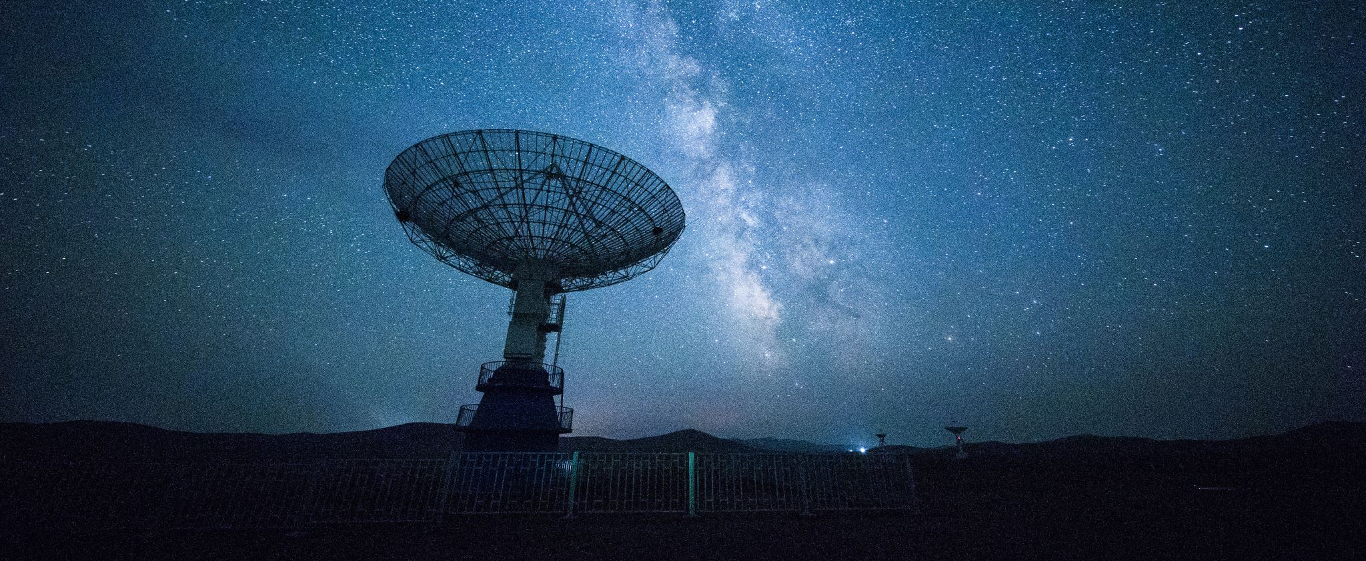
From the Schrödinger equation to telescope designing
M.Sc. seminar of Odeia Moshkovich
Advisor: Joan Adler
Consultant: Erez Ribak

Slide 2
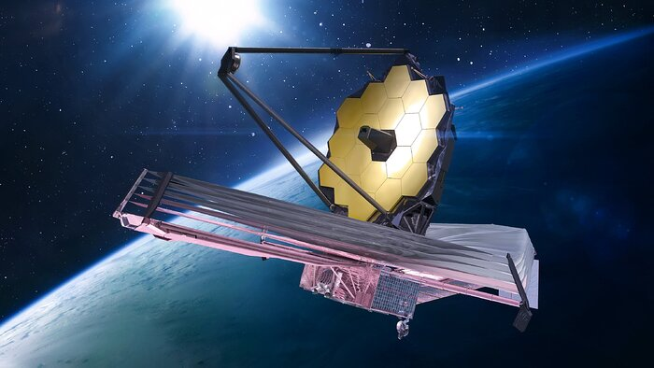
Outline
Introduction
MTF designing
Project guidelines
Numerical methods
Results
Conclusions
James Webb Space Telescope, by Dima Zel, NASA

Slide 3
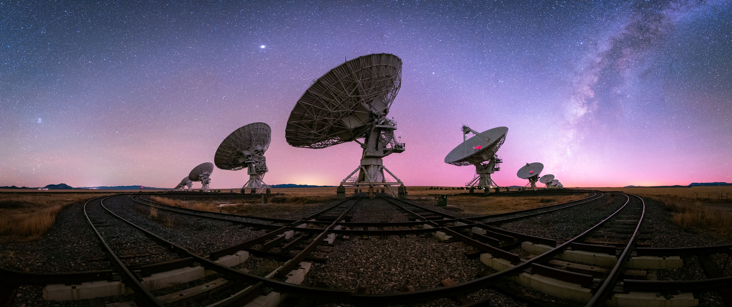
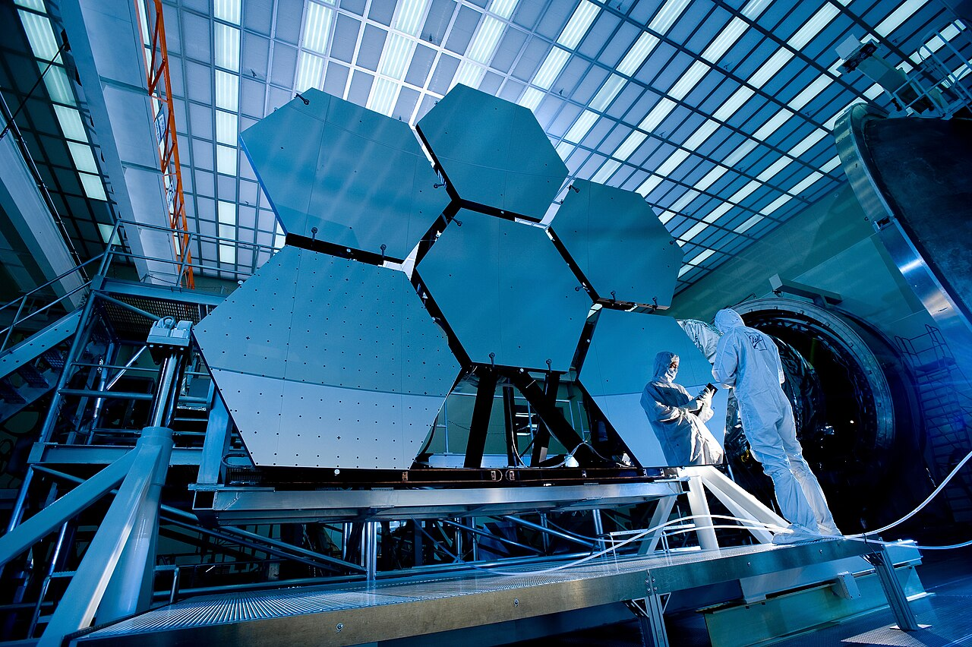
Sparse vs. segmented telescopes
IIII
Introduction
Introduction
A segmented/sparse telescope is composed of several lenses/mirrors combined forming one large telescope.
Sparse telescopes:
Arrays of far apart telescopes functioning as a single unit system.
Using interferometry to form images.
Used mostly for radio telescopes due to wavelength properties.
Focuses on angular resolution.
Segmented telescopes:
“Mosaic” form of telescopes.
Have a joint focal point for all segments.
Mostly suited for infrared to visible light.
Focuses on gathering light.
Very Large Array, by Karl G., National Radio Astronomy Observatory
James Webb Space Telescope, by NASA
Notes:
A segmented/sparse telescope is composed of several lenses/mirrors combined forming one large telescope.
Sparse telescopes are far apart telescopes, made of mirrors or lenses, which are functioning as a single unit
While Segmented telescopes are a “mosaic” form of telescope ( like James Webb) and act together as a single large mirror which also have a single focal point
While in sparse the way to form the images is by interferometry.
Sparse telescopes are used mostly for radio telescopes due to wavelength properties – but not solely (like VLT using visible).
Segmented telescopes are used mostly for visible-infrared light.

Slide 4
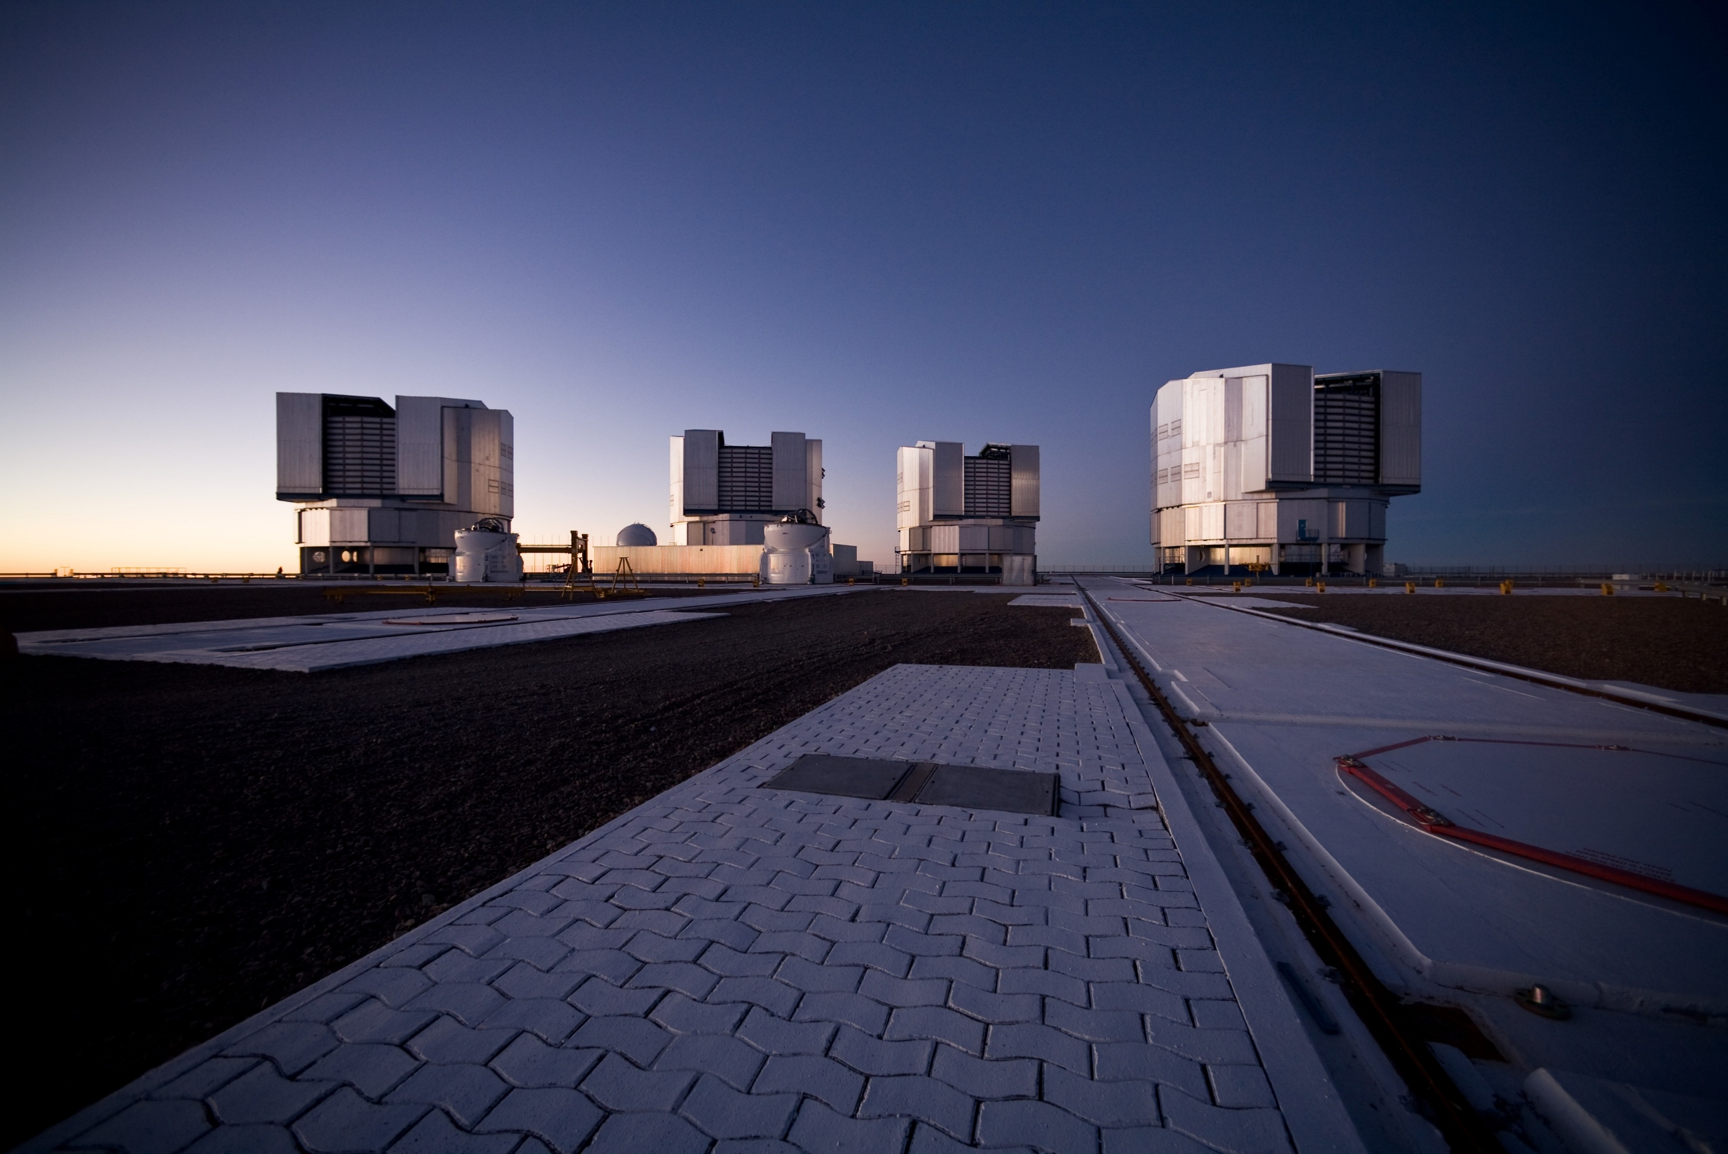
Benefits
IIII
Introduction
Introduction
Why sparse telescopes?
Why segmented telescopes?
Can be spaced out to large distances
Made of compact parts
Easier to manufacture
Made of compact parts
Achieve high angular resolution interferometry
Lightweight
These telescopes are the future of space imaging:
They lead to numerous significant discoveries over the years:
Keck telescope (2020 Nobel prize for Milkey Way black hole)
James Webb (early universe images, exoplanets, faint objects)
LIGO interferometer (gravitational waves)
Very Large Telescope (black holes, GR proving…)
Many leading large radio telescopes today are sparse.
Many future planned large telescopes are segmented/sparse.
Very Large Telescope, By H.H.Heyer, ESO
Notes:
So why even build sparse or segmented telescopes instead of a single full aperture?
Will start with sparse-
Each part can be spaced out to very large distances, even between different countries
And that what makes the angular resolution be so high, also compared to the total system size, building it from singular units is relatively compact
So why to use segmented apertures instead of a single full aperture?
They are way easier and cheaper to manufacture, and each segment is more lightweight and compact than a single big aperture
Actually there is a physical limit to how large a single aperture can get before it collapses under its own weight
And not to mention wanting to send this to space…
Segmented telescopes are becoming the future for space imaging.
, they can lead to significant discoveries as we know about, even nobel prizes, like of Andrea Ghez in 2020 for black hole discoveries, using Keck segmented telescope
Also the james webb telescope that we all know it importance to discoveries, LIGO for gravitational waves discovery, and there are more examples
VLT for proving GR for stars moving in gravitational field near a black hole
Many of the large telescopes leading today are sparse or segmented, and the future planned large ones are almost all designed like that

Slide 5
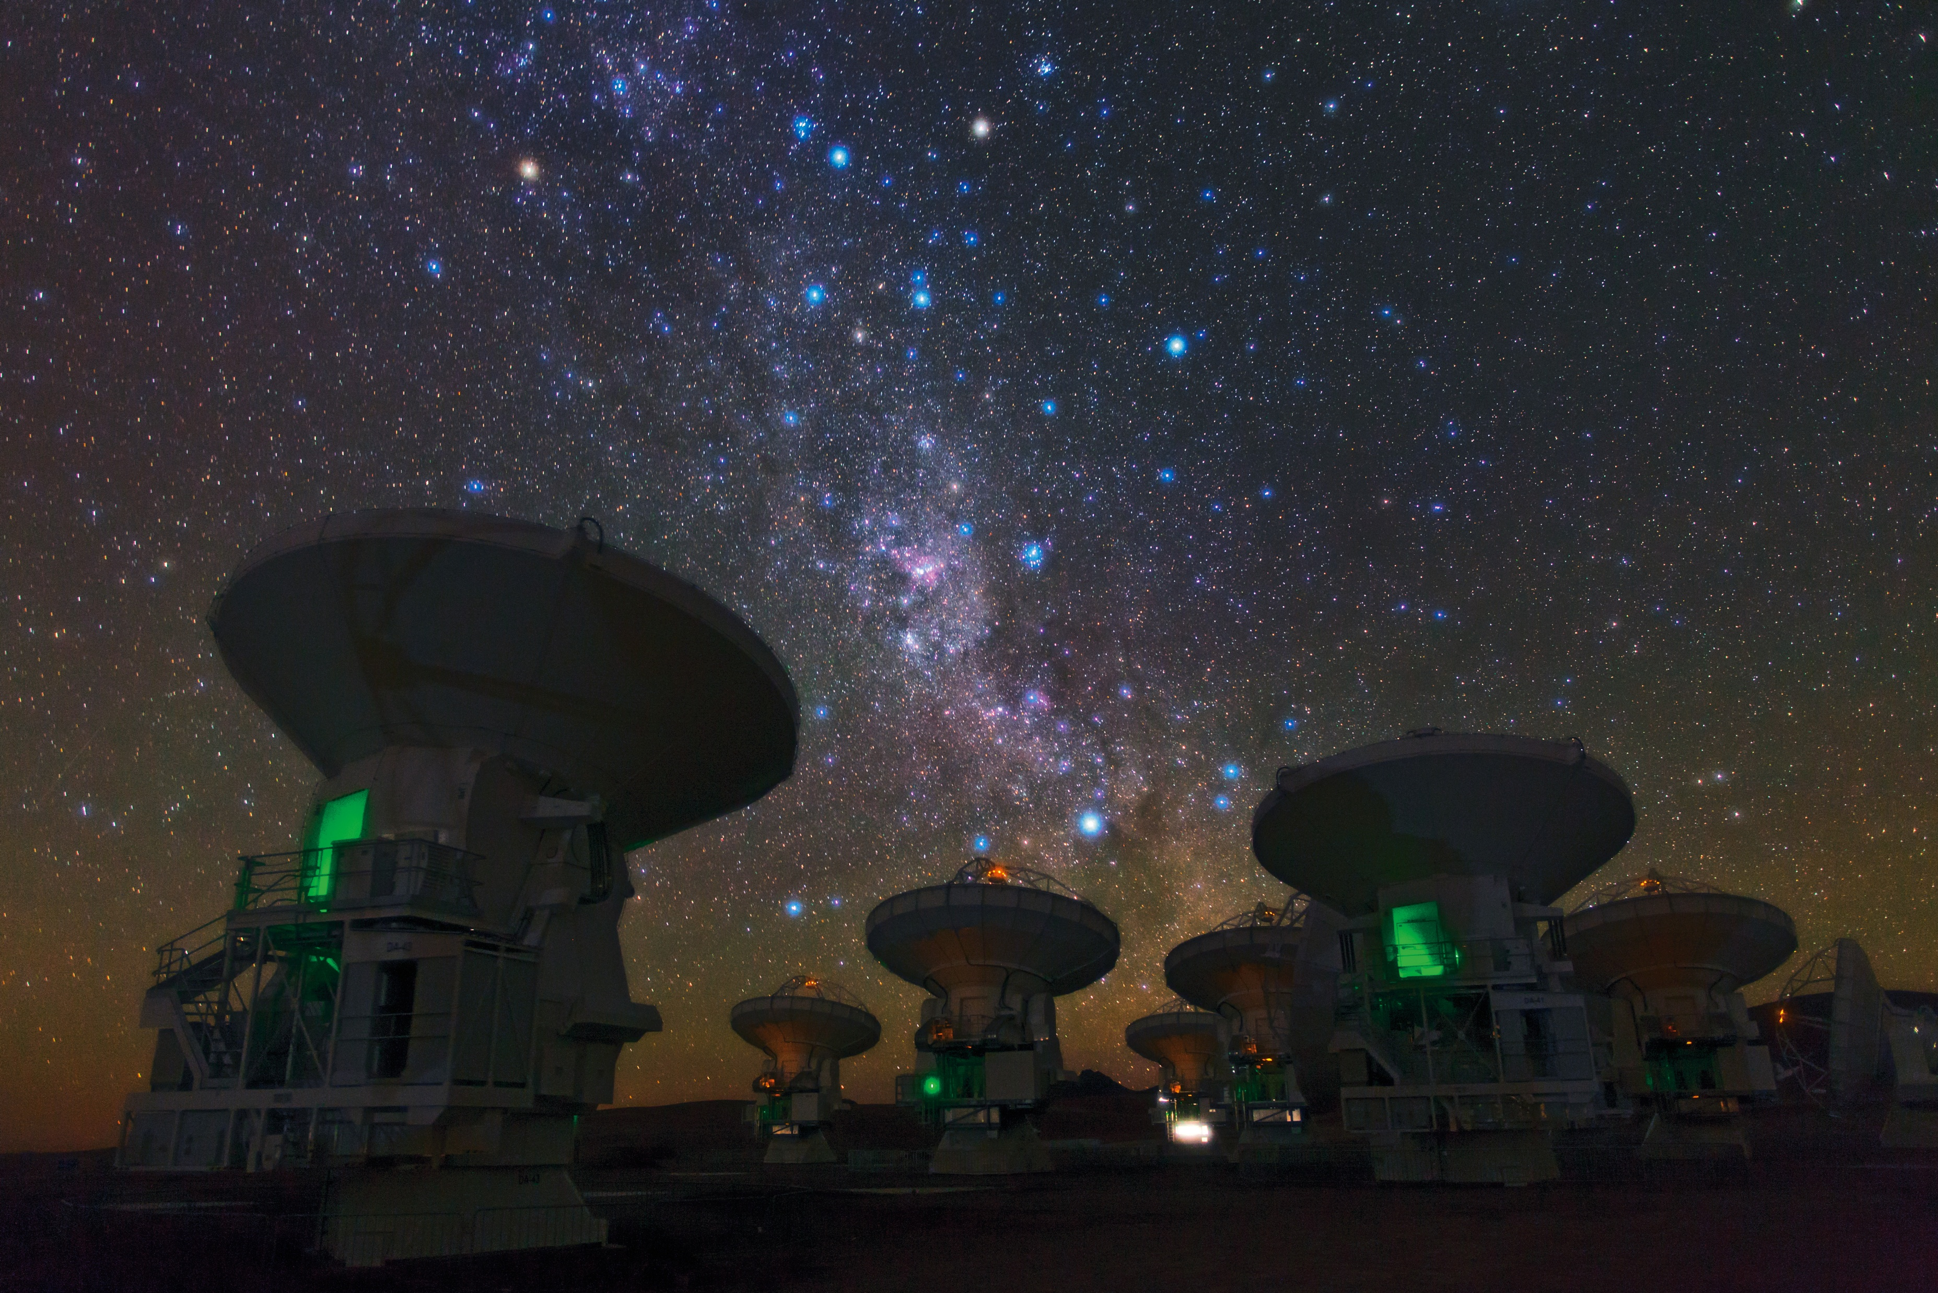

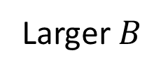
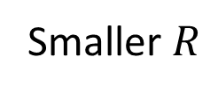
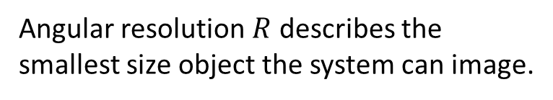
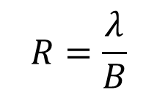
Angular resolution
Introduction
IIII
Angular resolution $R$ describes the smallest size object the system can image.
In telescope arrays, angular resolution is approximated by:
Radiation wavelength
$$R=\frac{λ}{B}$$
$$D$$
A baseline
Diameter
Largest baseline in the array
Aperture diameter
Larger $B$
Smaller $R$
Larger maximal baseline
Finer details imaging
Atacama Large Millimeter/submillimeter Array (ALMA), by Babak Tafreshi, ESO
Notes:
In telescope arrays we can define the angular resolution by this formula
Which describes the relation between the maximal baseline exists in the array and the smallest detail that the system can image
An object smaller than the resolution will be blurred, and everything above that resolution will be considered as a point source
The same formula is also applied to a single telescope with one aperture, and instead of a baseline it’s the diameter of the telescope
And we can see that when we have multiple apertures, even with a small diameter, we can get a way better angular resolution only by separate the apertures away from each other.
We can see the intuition for why is that the case in the next slides…

Slide 6
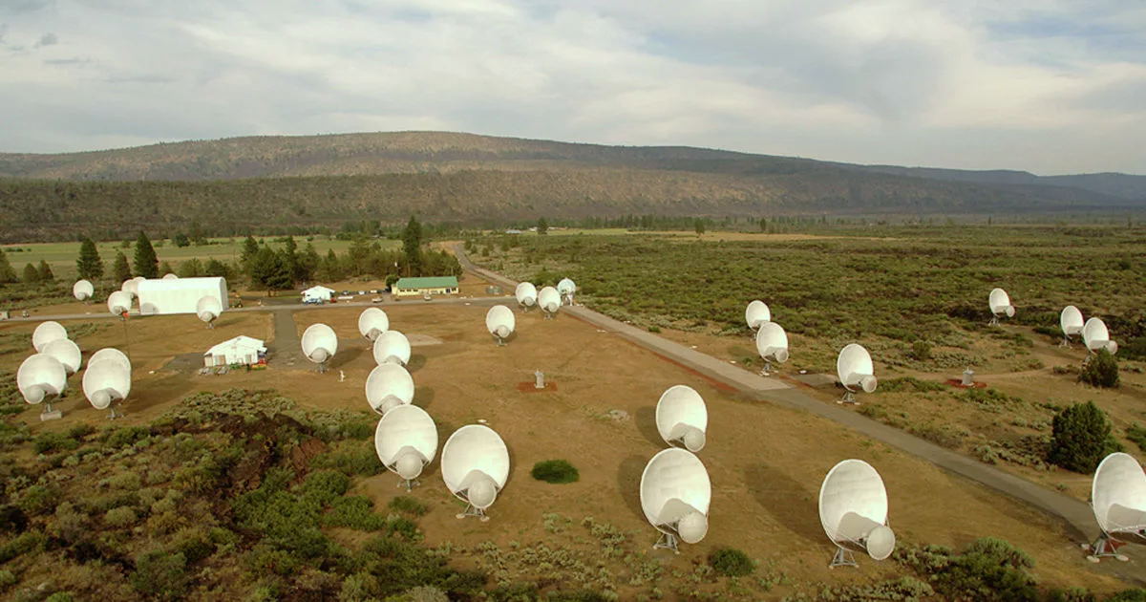
Challenges
Introduction
IIII
Why aren’t they more common?
Problems to overcome:
If the apertures are too sparse
If the apertures are too dense
Information loss
Redundant frequencies
Poor use of information
Hard to tell apart faulty apertures
The Allen Telescope Array, by Seth Shostak, The SETI Institute
Notes:
But there is a reason why there are only limited examples for sparse or segmented telescopes in todays use
The gaps between the segments means less light is gathered, and spatial frequencies are getting lost
If the apertures are too close to each other that creates the opposite problem-the same spatial frequency multiple times, and that’s called redundancy
Redundancy itself isn’t wanted (especially in sparse telescopes) because if the frequency is received twice, that is a waste of information capacity, and instead that information could be received as a high frequency the system didn’t have, which means it could increase the image sharpness
Another thing is that a wise arrangement without redundancies will bring the system a “one to one” connection between the apertures and the frequencies it creates. That means that if we have redundancy we lose that property and if an aperture isn’t placed correctly or something happens to it, it will be hard to know from the frequencies picture or the MTF which aperture is the faulty one
But its hard to organize the apertures in a non redundant way, and that is a well known problem of decades of research

Slide 7
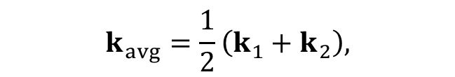








Basic background
Introduction
A simple plane wave can be described by:
$$E=Ee^{i\left(ωt−k⋅r\right)}\overset{ˆ}{k}$$
frequency
Spatial frequency
2 interfering plane waves can be described by:
$$E_{1}$$
$E=E_{1}​+E_{2}=Ae^{i\left(ωt−k_{1}⋅r\right)}{\overset{ˆ}{k}}_{1}+Ae^{i\left(ωt−k_{2}⋅r\right)}$ ${\overset{ˆ}{k}}_{2}$
$$k_{2}$$
Which can be written as:
$$θ$$
$E=2Ae^{i\left(ωt−k_{avg}⋅r\right)}\cos\left(\frac{Δk⋅r}{2}\right)$ ${\overset{ˆ}{k}}_{avg}$
$$k_{1}$$
$$k_{avg}=\frac{1}{2}\left(k_{1}+k_{2}\right),$$
Where:
$Δk=k_{1}​−k_{2}​$,
$$r=(x,y,z)$$
$$E_{2}$$
Notes:
This is a small optics background to give some intuition
A plane wave can be written like that, and when two plane waves are interfere with a different spatial frequency, or angle in other words, we can write it like that

Slide 8
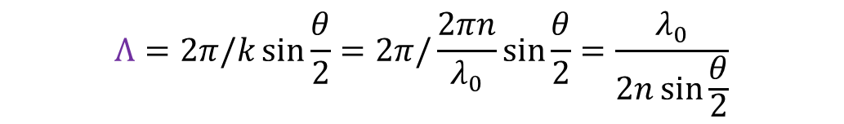
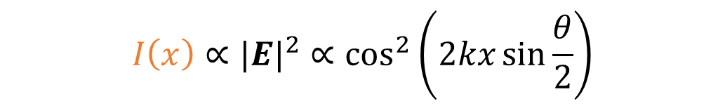
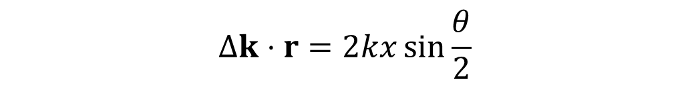

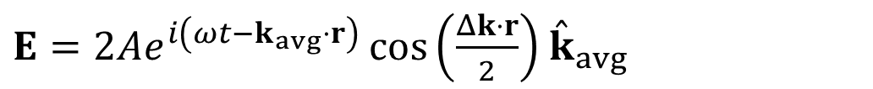



Basic background
Introduction
$E=2Ae^{i\left(ωt−k_{avg}⋅r\right)}\cos\left(\frac{Δk⋅r}{2}\right)$ ${\overset{ˆ}{k}}_{avg}$
Wider angle
$$=$$
frequent fringes
$$=$$
For 2 waves interfere on the $\hat{x}$ axis:
larger spatial frequency achieved
$$Δk⋅r=2kx\sin{\frac{θ}{2}}$$
$$E_{1}$$
$$I\left(x\right)$$
$$I\left(x\right)∝{|E|}^{2}∝\cos^{2}\left(2kx\sin{\frac{θ}{2}}\right)$$
$$θ$$
$$Λ$$
$$Λ=2π/k\sin{\frac{θ}{2}}=2π/\frac{2πn}{λ_{0}}\sin{\frac{θ}{2}}=\frac{λ_{0}}{2n\sin{\frac{θ}{2}}}$$
When:
$$E_{2}$$
Notes:
The cosine is the important part because when we take the absolute square of it, this is the part that remains and it will look like picks and valleys on the screen
$Λ$describes the distance between the finest detail which can be seen in the imaging system, $λ_{0}$is the wave length in vacuum, $θ$is the maximal angle from which light can be gathered.
In other words the wider the angle theta could be, or the wider the distance between 2 light waves can interfere
The finer the details in the interference pattern on the screen
That is also why wider lenses or mirrors create better quality images
So why even break that big lens or mirror apart and use segments? …..

Slide 9



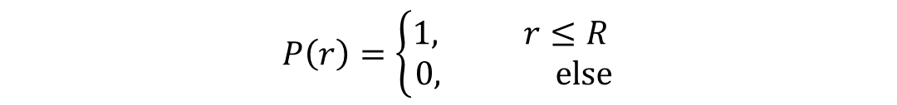

Aperture function definition
MTF designing
IIIIIIIIIIIIIII
Every imaging system uses apertures (lenses, mirrors, holes…).
The aperture function $P\left(x,y\right)$ describes how light is affected from transmission through the imaging system.
$$P\left(x,y\right)=A(x,y)∙e^{iθ(x,y)}$$
Full pass: $P\left(x,y\right)=1$
No pass: $P\left(x,y\right)=0$
Amplitude change inside the optics
Phase change inside the optics
In our case – each aperture is a full pass hole, no phase.
$$A(x,y)=1$$
$$θ(x,y)=0$$
For a single round hole, the aperture function can be written as:
$$R$$
$$P\left(r\right)=\left\{\begin{aligned}1, r≤R \\ 0, else\end{aligned}\right.$$
$r=$ $\sqrt{x^{2}+y^{2}}$
Notes:
First of all we need to define the aperture function or the pupil function
The aperture function describes how light is affected by the optics its passing through
If there are any aberration in the aperture or any additional phase – it will be described in that function
There is an amplitude part for any attenuation and a phase part to include the phase the light gets when passing through the aperture
For a full atteniuation – A is 0, no light passes
For a full pass, A=1, all the light passes
In our case each aperture acts like a hole letting the light passing through fully, that means amplitude 1 and no phase, only gives a shape of a circle with a radius R

Slide 10
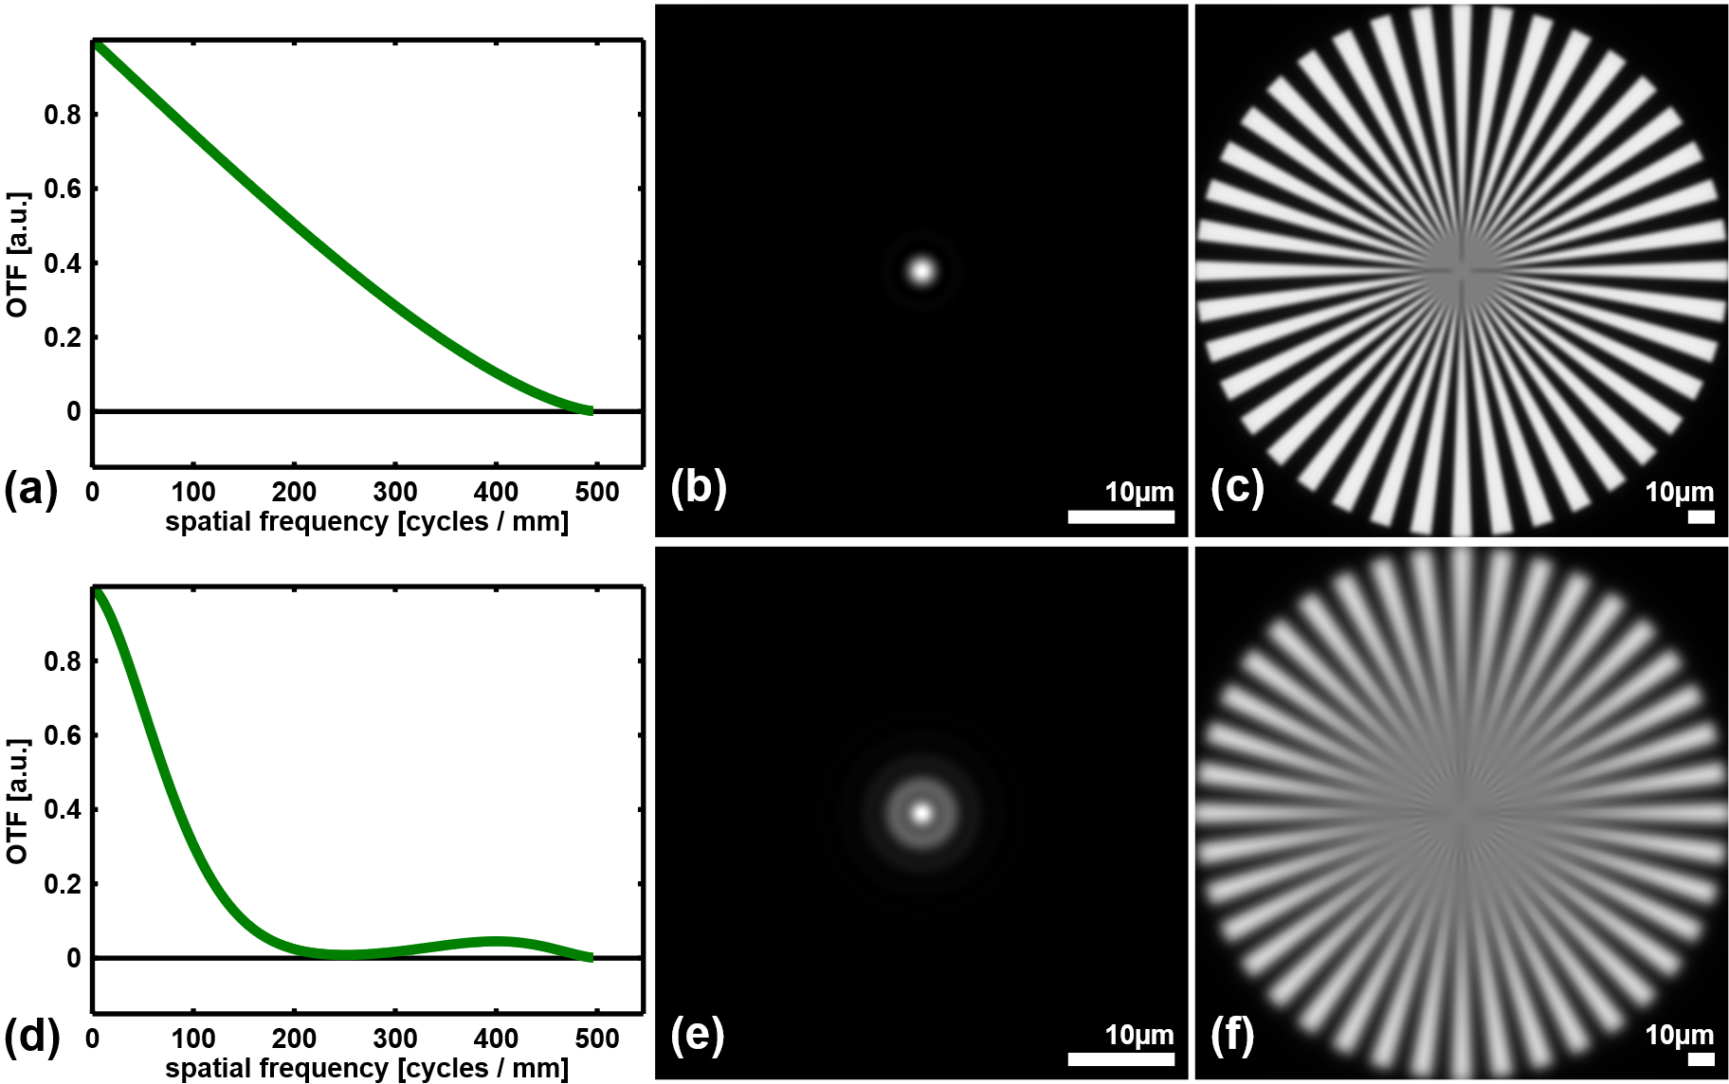
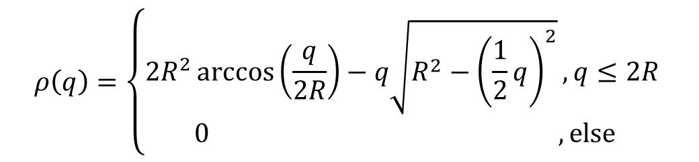
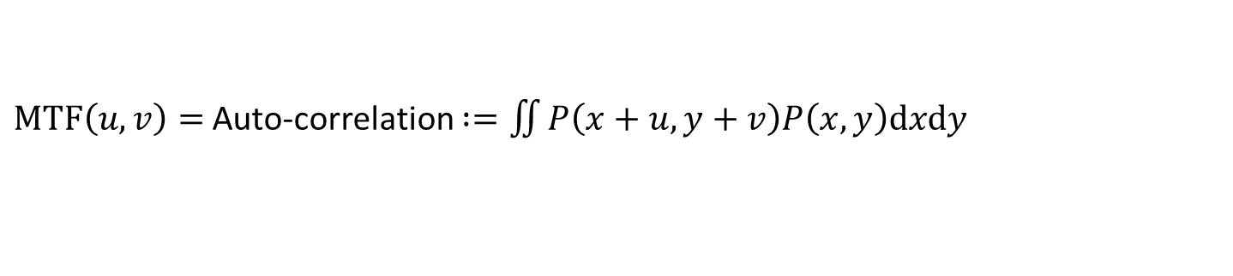
MTF definition
MTF designing
IIIIIIIIIIIIIII
The MTF describes the spatial frequency transmittance of the imaging system. In our case:
Modulation Transfer Function
$MTF\left(u,v\right)=$ Auto-correlation $:=\iint{P\left(x+u,y+v\right)P\left(x,y\right)\text{d}x\text{d}y}$
Aperture function
Higher frequencies transmitted
Sharper imaging
The MTF of a round hole:
Cut-off frequency
$$ρ\left(q\right)=\left\{\begin{aligned}2R^{2}\arccos\left(\frac{q}{2R}\right)−q\sqrt{R^{2}−{\left(\frac{1}{2}q\right)}^{2}},q≤2R \\ &0 ,else\end{aligned}\right.$$
MTF
$q=\left|q\right|$= $\sqrt{u^{2}+v^{2}}$
MTF
Illustration of MTF impact on image quality, by Tom.vettenburg, Wikipedia
Notes:
In imaging optics, a widely accepted measure of system performance is the OTF (Optical Transfer Function) and the MTF (Modulation Transfer Function), which characterizes the distribution of spatial frequencies transmitted through the optical system. The differences between them is only the phase of the light and for us it’s the same. We will focus on the MTF here. The MTF is typically defined over a two-dimensional frequency plane, denoted by coordinates $\left(u,v\right)$,
where the value of the function at each point (up to a normalization constant) reflects the relative transmission amount of the corresponding spatial frequency. The highest frequencies transmitted, which are located furthest from the origin, are referred to as the cut-off frequencies
The higher the cut-off frequency – the sharper the image
This is a nice illustration i found explaining the relation between the OTF or the MTF to the image quality, the more frequencies we lose from the MTF, the less sharp the image
The middle images are of a point source (PSF), which looks smeared in a poor MTF system
So this is important to have a good MTF without zeros that resembles loss of mid-range frequencies,
So how we do that? We will start by try to calculate the MTF
We can calculate with the integral or by another methos which is the Fourier transform of the PSF (point spread function), here we used the first methos because it takes less time to calculate in this case and it is also more intuitive to explain that way
The MTF by the Autocorrelation can be calculated very easily when considering points instead of finite sized apertures

Slide 11

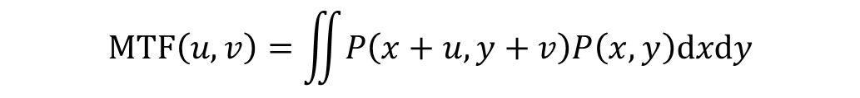











Auto-correlation calculation
MTF designing
IIIIIIIIIIIIIII
$$MTF\left(u,v\right)=\iint{P\left(x+u,y+v\right)P\left(x,y\right)\text{d}x\text{d}y}$$
How to calculate auto-correlation?
Point-like 1D example:
$$2$$
Real space
$$\hat{x}$$
$$(−2,0)$$
$$(−1,0)$$
$$(0,0)$$
$$(1,0)$$
$$(2,0)$$
Auto-correlation space
1
2
1
$$\hat{u}$$
$$(0,0)$$
$$(2,0)$$
$$(−2,0)$$
$$(2,0)$$
Notes:
Autocorrelation can be calculated very easily when considering points instead of finite sized apertures
Heres a simple example for 2 point like apertures
This is how their auto-correlation would be calculated:
An autocorrelation is an integral over space of some structure with itself, so for that we can put in place the configuration and get the same configuration moving along space, and when it covers up the standing configuration their product sums up, and the sum will be a value in the autocorrelation space
The place in autocorrelation space is mapped to be the distance that was needed to be between the 2 shapes for them to coincide

Slide 12






Redundancy
MTF designing
IIIIIIIIIIIIIII
$$MTF\left(u,v\right)=\iint{P\left(x+u,y+v\right)P\left(x,y\right)\text{d}x\text{d}y}$$
How to calculate auto-correlation?
Point-like 1D example:
Real space
$$\hat{x}$$
$$(−2,0)$$
$$(−1,0)$$
$$(0,0)$$
$$(1,0)$$
$$(2,0)$$
Redundancy!
1
2
2
$$\hat{u}$$
Auto-correlation space
3
2
1
1
$$(−2,0)$$
$$(−1,0)$$
$$(0,0)$$
$$(1,0)$$
$$(2,0)$$
Notes:
Here is another 1D example
There is also another way of thinking about this auto-correlation, and this is looking at the vectors between each couple of apertures, the green one is repeated once in this configuration, and that means in the place of the size of the green vector, there will be a point equals 1
The orange vector is repeated twice along the configuration, and that means in the place which is the size of the orange vector – we will have the height of 2
And this is a redundancy!
It appeared because the same vector is repeated twice along the configuration, and the outcome of it is the height of more than 1 in the auto-correlation space
More than 1 is considered redundant because in that spot you cant tell the difference between which couple of apertures brought to create that point in auto-correlation space
The center point is always with the height of the number of apertures we have in the configuration because naturally each aperture has an auto-correlation with itself without moving, that means in the vector of 0 we will have 1 for each aperture
We will mostly ignore the center because this is trivial and we cant do much about it anyway
But with the rest of the points in auto-correlation space – they are determined only by our organizing of the aperture in space
so
That means that if we want to create a non-redundant configuration we need to not repeat a vector twice between couples of apertures, and this is not a trivial task when there are more apertures, because even here we see we need to move away one of them to have bigger space between it and the other 2
But when there are more apertures, moving one affects every single one of the rest of the apertures, and maybe others will get redundant by that
And on the other hand we don’t want to distance them too much apart because that will create holes in the autocorrelation space, which means losing that spatial frequency from the image
So now you maybe can get a feeling about the complexity of this problem
And this is why over decades there were many different suggestions for organizing apertures the optimal way
But we will see soon the pros and cons of some of these suggestions and why there is place for more
Another thing worth mentioning here is that in the continuous limit – when the aperture is one single big aperture, an can be made of continuous points in a row
Their MTF will become something similar to a triangle

Slide 13
Finite radius apertures
MTF designing
IIIIIIIIIIIIIII
$$MTF\left(u,v\right)=\iint{P\left(x+u,y+v\right)P\left(x,y\right)\text{d}x\text{d}y}$$
From point-like to a finite 1D radius aperture
A finite size aperture can be described as a series of infinitely small points
In 1D the auto-correlation of equally spaced points is a triangle
Notes:
In other words, after understanding intuitively how to calculate the auto-correlation for point-like configurations
Extend that into finite radius apertures from there – we can convolve the configuration of singular points with the shape of a continuous aperture
What we will get is that instead of every point in the autocorrelation space – we will get a spread-out point with the structure of a cone

Slide 14
Finite radius apertures
MTF designing
IIIIIIIIIIIIIII
From point-like to a finite 1D radius aperture
Real space:
Auto-correlation space:
Notes:
In other words, after understanding intuitively how to calculate the auto-correlation for point-like configurations
Extend that into finite radius apertures from there – we can convolve the configuration of singular points with the shape of a continuous aperture
What we will get is that instead of every point in the autocorrelation space – we will get a spread-out point with the structure of a cone
We can see here that for that radius of apertures – from a certain distance between them, we will get zeros in the MTF or auto-correlation
And if the apertures are

Slide 15
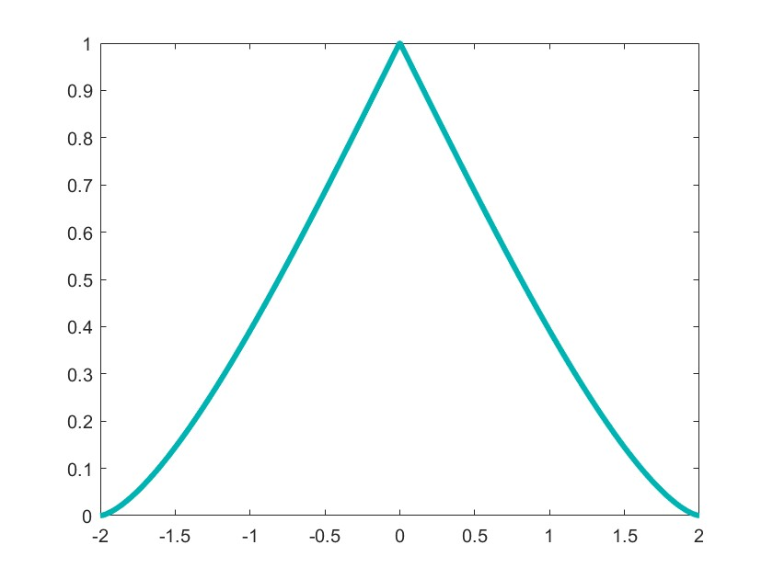
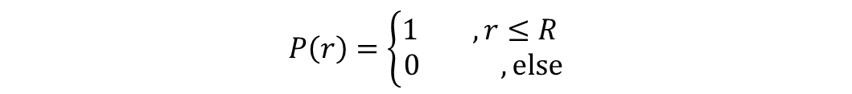
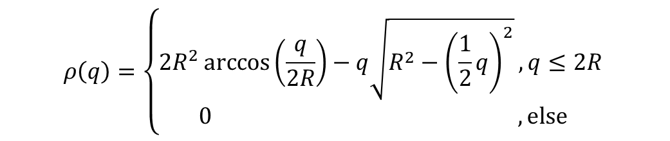
Finite radius apertures
MTF designing
IIIIIIIIIIIIIII
$$MTF\left(u,v\right)=\iint{P\left(x+u,y+v\right)P\left(x,y\right)\text{d}x\text{d}y}$$
From point-like to a finite 2D radius aperture
$$P\left(r\right)=\left\{\begin{aligned}1 , r≤R \\ 0 ,else\end{aligned}\right.$$
Auto-correlation function of a circle:
$$ρ\left(q\right)=\left\{\begin{aligned}2R^{2}\arccos\left(\frac{q}{2R}\right)−q\sqrt{R^{2}−{\left(\frac{1}{2}q\right)}^{2}},q≤2R \\ &0 ,else\end{aligned}\right.$$
$q=\left|q\right|$= $\sqrt{u^{2}+v^{2}}$
Notes:
In other words, after understanding intuitively how to calculate the auto-correlation for point-like configurations
Extend that into finite radius apertures from there – we can convolve the configuration of singular points with the shape of a continuous aperture
What we will get is that instead of every point in the autocorrelation space – we will get a spread-out point with the structure of a cone

Slide 16
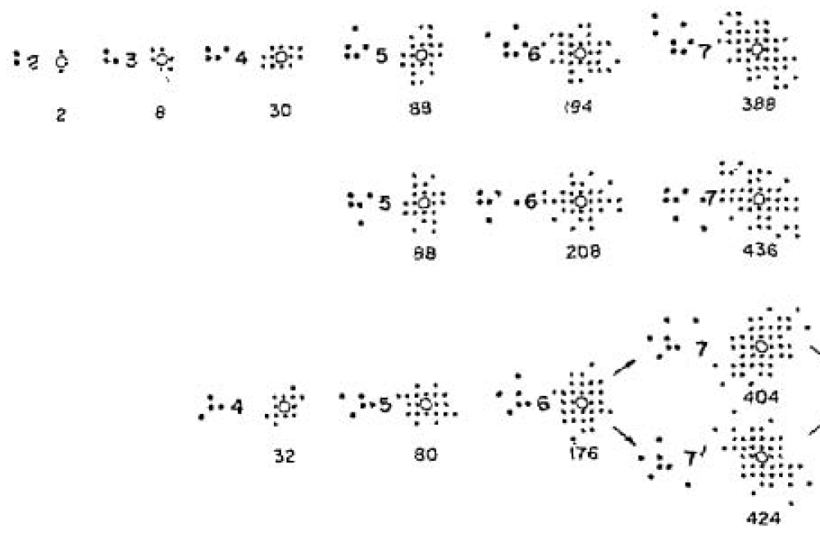
Previous work
MTF designing
IIIIIIIIIIIIIII
Golay, 1971
Square grid
Golay, M. J. (1971). Point arrays having compact, nonredundant autocorrelations. Journal of the Optical Society of America, 61(2), 272-273.
Notes:
Golay was the first to suggest an algorithm to organize apertures, in square lattice, triangular lattice, and one with 60 degrees symmetry
and what his algorithm does is to make the most compact configuration – in real space
And the auto-correlation (or MTF) is whatever the configuration brings, with no any preference
He did calculated the MTF “moment of inertia” as a way to differ one configuration from the other, but if a certain number of apertures yields several configuration options, he would just put them all with the moment of inertia for each and let the people choose whatever they liked better
Golays algorithm is considered the pioneer in this field, and most of the times papers with different algorithms will compare theirs to golays
His algorithm is not a very sophisticated one, and there are better ones out there
Even with the same goal of making a compact configuration in real space
And this is because his algorithm isn’t unique to each number of apertures, but each additional aperture is added to the current configuration, instead of organizing everything from scratch
So this algorhtim is very simple, with the cost of that it gives less ideal results

Slide 17
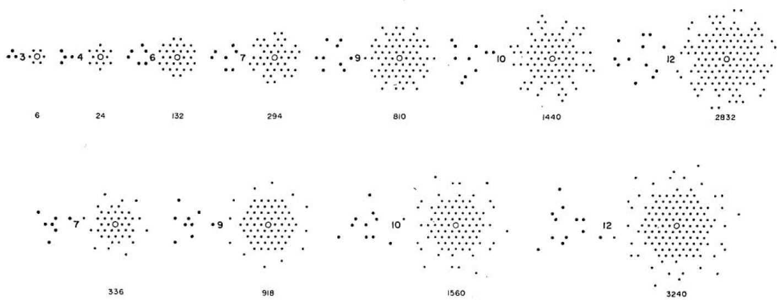
Previous work
MTF designing
IIIIIIIIIIIIIII
Golay, 1971
Triangular grid
Golay, M. J. (1971). Point arrays having compact, nonredundant autocorrelations. Journal of the Optical Society of America, 61(2), 272-273.
Notes:
Golay was the first to suggest an algorithm to organize apertures with no redundancy, in square lattice, trigangular lattice, and one with 60 degrees symmetry
and what his algorithm does is to make the most compact configuration – in real space
And the auto-correlation (or MTF) is whatever the configuration brings, with no any preference
He did calculated the MTF “moment of inertia” as a way to differ one configuration from the other, but if a certain number of apertures yields several configuration options, he would just put them all with the moment of inertia for each and let the people choose whatever they liked better
Golays algorithm is considered the pioneer in this field, and most of the times papers with different algorithms will compare theirs to golays
His algorithm is not a very sophisticated one, and there are better ones out there
Even with the same goal of making a compact configuration in real space
And this is because his algorithm isn’t unique to each number of apertures, but each additional aperture is added to the current configuration, instead of organizing everything from scratch
So this algorhtim is very simple, with the cost of that it gives less ideal results

Slide 18
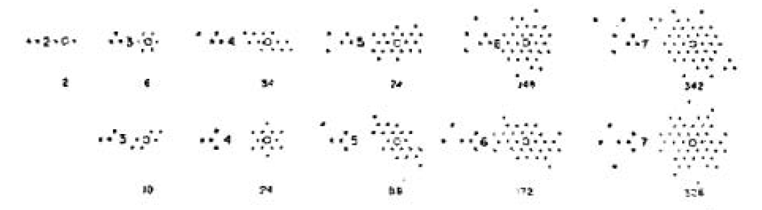
Previous work
MTF designing
Golay, 1971
Triangular grid
Golay, M. J. (1971). Point arrays having compact, nonredundant autocorrelations. Journal of the Optical Society of America, 61(2), 272-273.
Notes:
Golay was the first to suggest an algorithm to organize apertures, in square lattice, trigangular lattice, and one with 60 degrees symmetry
and what his algorithm does is to make the most compact configuration – in real space
And the auto-correlation (or MTF) is whatever the configuration brings, with no any preference
He did calculated the MTF “moment of inertia” as a way to differ one configuration from the other, but if a certain number of apertures yields several configuration options, he would just put them all with the moment of inertia for each and let the people choose whatever they liked better
Golays algorithm is considered the pioneer in this field, and most of the times papers with different algorithms will compare theirs to golays
His algorithm is not a very sophisticated one, and there are better ones out there
Even with the same goal of making a compact configuration in real space
And this is because his algorithm isn’t unique to each number of apertures, but each additional aperture is added to the current configuration, instead of organizing everything from scratch
So this algorhtim is very simple, with the cost of that it gives less ideal results

Slide 19
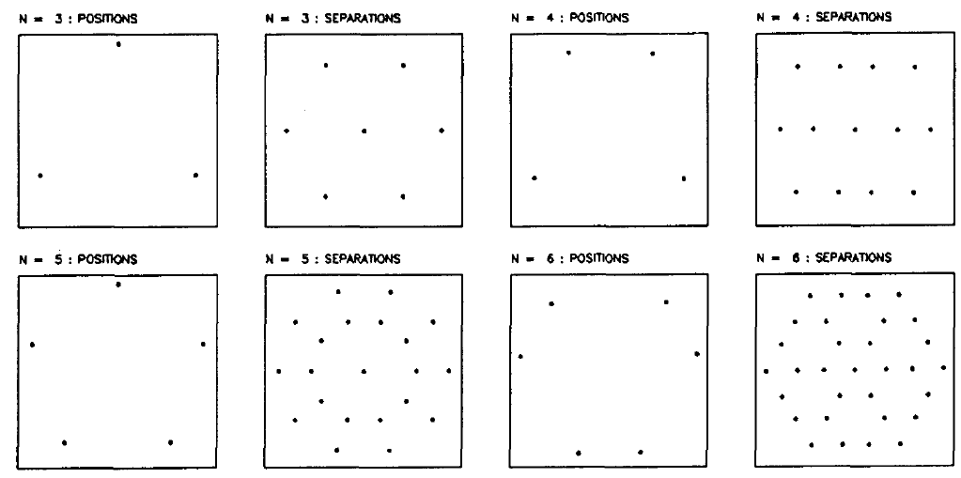
Previous work
MTF designing
IIIIIIIIIIIIIII
Cornwell, 1988
On circle
Cornwell, T. J. (1988). Radio-interferometric imaging of very large objects. Astronomy and Astrophysics (ISSN 0004-6361), vol. 202, no. 1-2, Aug. 1988, p. 316-321., 202, 316-321.
Notes:
Cornwell is also a classic configuration series
His algorithm aspires to create the MTF with the greatest cut-off with evenly spread points as possible in between, given the apertures are placed on a circle, so that the configuration has still a non redundant MTF
He used an algorithm which is called simulated annealing , we will talk about this algorithm later on
For now it is only to mention that the symmetric and beautiful sturcutres arraised naturally from the algorithm, and it was not planned

Slide 20
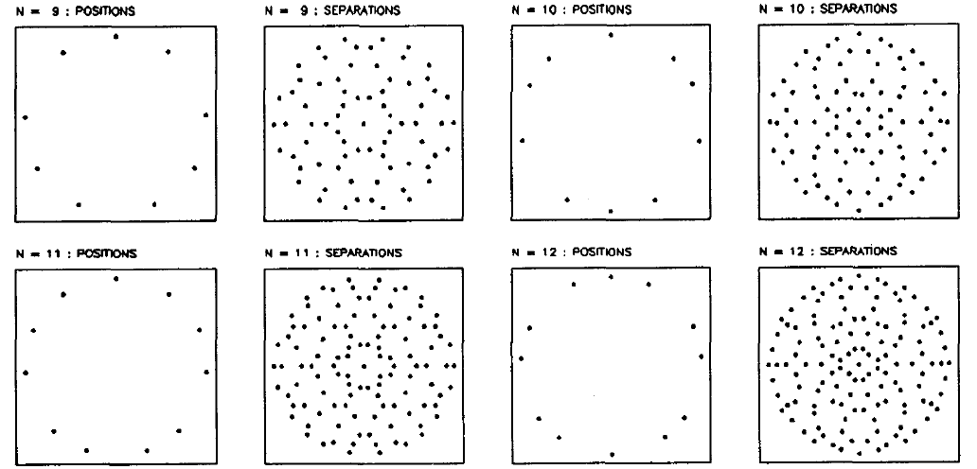
Previous work
MTF designing
IIIIIIIIIIIIIII
Cornwell, 1988
On circle
Cornwell, T. J. (1988). Radio-interferometric imaging of very large objects. Astronomy and Astrophysics (ISSN 0004-6361), vol. 202, no. 1-2, Aug. 1988, p. 316-321., 202, 316-321.
Notes:
You can notice that it is almost a circle, but with holes
Because if it was a full circle – everything was redundant twice, because every vector has a parallel one in the other side

Slide 21
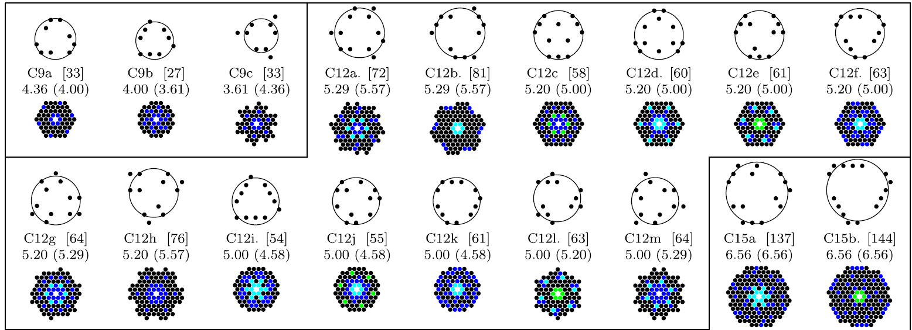
Previous work
MTF designing
IIIIIIIIIIIIIII
Cassaing and Mugnier, 2018
Triangular grid
Redundancy color key: 1 2 3 4
Cassaing, F., & Mugnier, L. M. (2018). Optimal sparse apertures for phased-array imaging. Optics letters, 43(19), 4655-4658.
Notes:
Mugnier is currently one of the main people actively working on this problem
One work that he published is this one,
Here he did a systematic search (which means he put several solutions with different values)
Where the main goal is to create compact configurations, without holes, but with the cost of redundancy
The redundancy marked as different colors

Slide 22
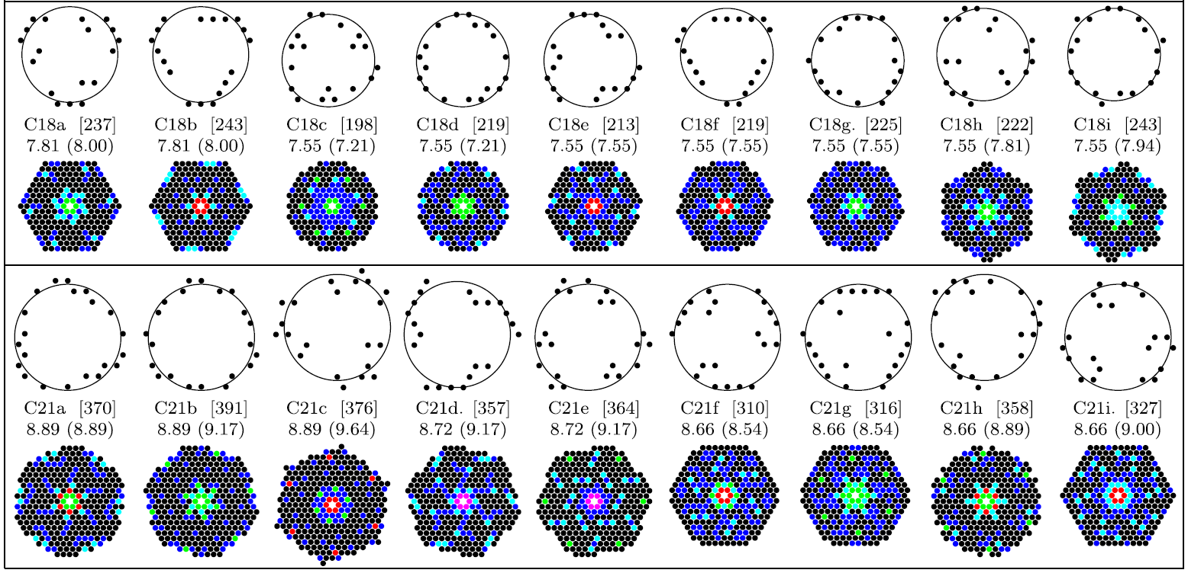
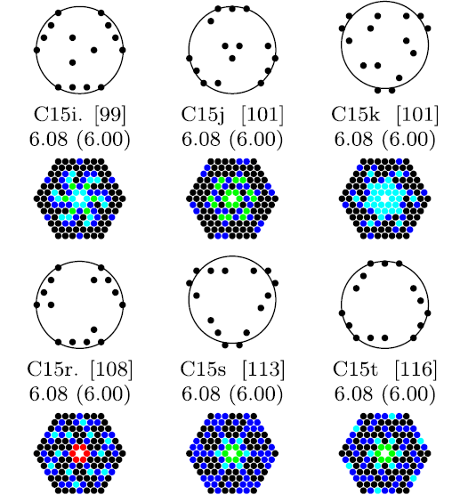
Previous work
MTF designing
IIIIIIIIIIIIIII
Cassaing and Mugnier, 2018
Triangular grid
Redundancy color key: 1 2 3 4 5 6
Cassaing, F., & Mugnier, L. M. (2018). Optimal sparse apertures for phased-array imaging. Optics letters, 43(19), 4655-4658.
Notes:
Mugnier is currently one of the main people actively working on this problem
One work that he published is this one,
Here he did a systematic search (which means he put several solutions with different values)
Where the main goal is to create compact configurations, without holes, but with the cost of redundancy
The redundancy number is marked as different colors

Slide 23
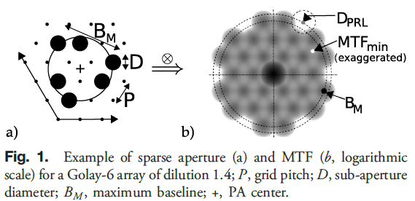
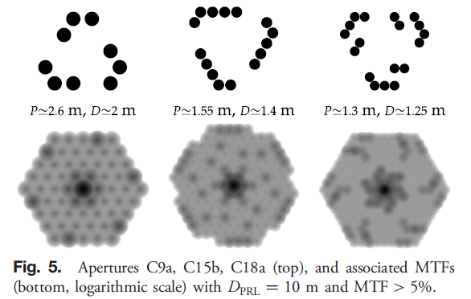
Previous work
MTF designing
IIIIIIIIIIIIIII
Cassaing and Mugnier, 2018
Triangular grid
Cassaing, F., & Mugnier, L. M. (2018). Optimal sparse apertures for phased-array imaging. Optics letters, 43(19), 4655-4658.
Notes:
Another thing they did worth mentioning is that they used a calculated distancing between each aperture based on their radius, so the coverage is what they considere optimal
So in a picture when the apertures aren’t point like but have a finite radius, the MTF is actually this

Slide 24
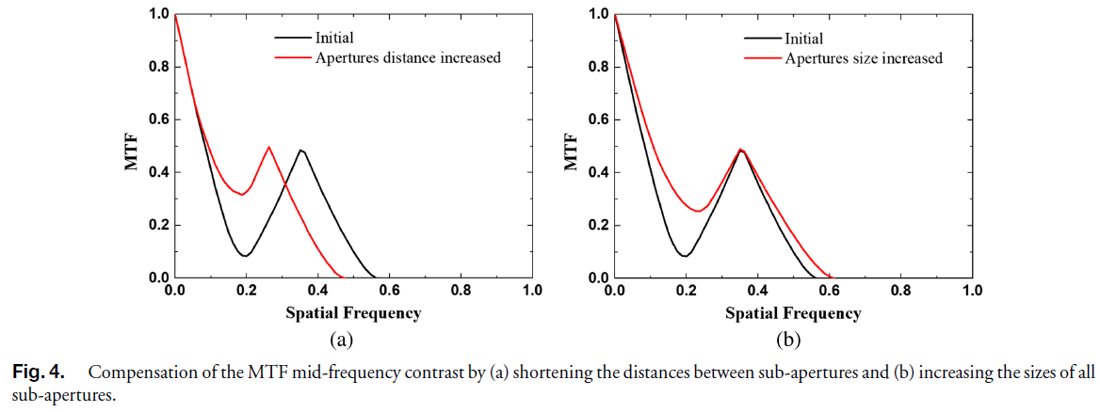
Previous work
MTF designing
IIIIIIIIIIIIIII
Tai Liu et al., 2024
Triangular grid
Liu, T. et al. (2024). Mid-frequency contrast compensation for sparse aperture imaging systems by a larger sub-aperture. Applied Optics, 63(31), 8082-8090.‏
Notes:
A recent work of Tai Liu and some other people was to demonstrate the effect of different changes on the aperture in order to avoid mid-frequency loss
Which is what Mugnier did as well but he fixed a distance compared to the apertures radius
But here they measure separately the effect of changing the distance between apertures on the dip in the middle, and also how the changing in radius affect that dip
But we cant always increase the size of our aperture,
And changing the distance is nice but not trivial, because getting the aperture closer together can create a redundancy

Slide 25
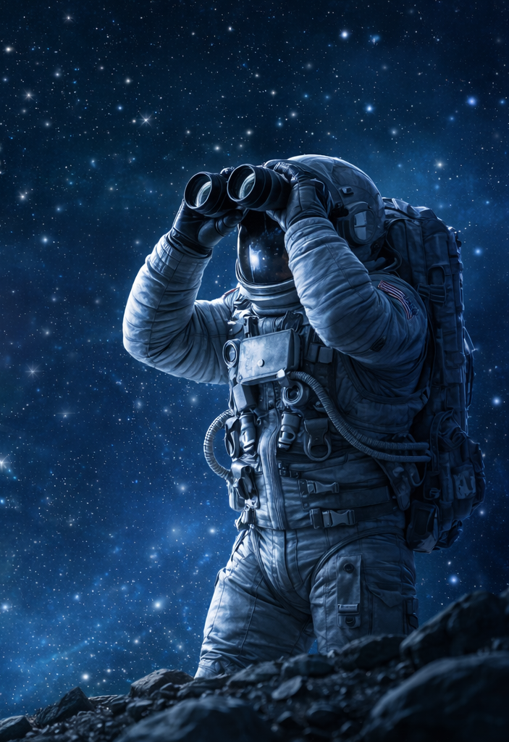
Project goals
Project guidelines
II
Maximize MTF uniformity
Minimize mid-frequency losses
Non-redundant
Compact MTF
Notes:
So after discussing some selected previous work
Now its time to talk about our own project and its place in this field

Slide 26

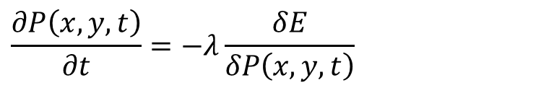
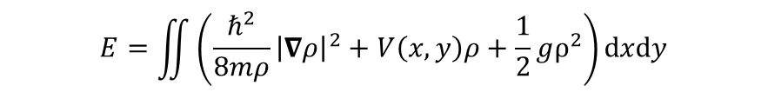
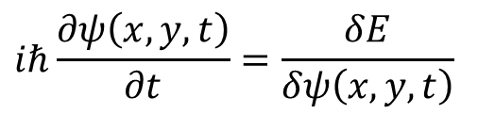

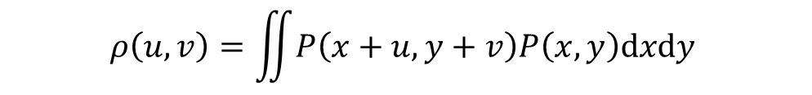
System description
Project guidelines
II
Approach:
Particles
Apertures
$$ψ\left(x,y\right)$$
$$P\left(x,y\right)$$
Auto-correlation function
Particles density function
$$ρ\left(u,v\right)=\iint{P\left(x+u,y+v\right)P\left(x,y\right)\text{d}x\text{d}y }$$
$$ρ(x,y)=ψ\left(x,y\right)ψ^{∗}\left(x,y\right)$$
analogy
Equation of motion
Equation of motion
$$\frac{∂P\left(x,y,t\right)}{∂t}=−λ\frac{δE}{δP\left(x,y,t\right)}$$
$$iℏ\frac{∂ψ\left(x,y,t\right)}{∂t}=\frac{δE}{δψ\left(x,y,t\right)}$$
“Energy”
Energy
$$E=\iint{\left(c{\left|∇ρ\right|}^{2}+V\left(u,v\right)ρ+\frac{1}{2}gρ^{2}\right)\text{d}u\text{d}v}$$
$$E=\iint{\left(\frac{ℏ^{2}}{8mρ}{\left|∇ρ\right|}^{2}+V\left(x,y\right)ρ+\frac{1}{2}gρ^{2}\right)\text{d}x\text{d}y}$$
Notes:
So how are we achieving our goals?
With the following approach:
The idea is creating an analog between our apertures and particles that are governed by the forces inside a non-linear shcrodinger system
That way, the forces our “particles” feel, make them move in real space so that their MTF is the most smooth, which - with the selected forces, is the state where the energy is minimal
How is that the case?
We can look at our energy:
The gradient term is minimal when there are less differences between values in the MTF, because that is when the derivatives are the smallest. In other words that term alone makes the apertures move in such a way the MTF is the smoothest
But we also have another term which is the non linear term, we added it here to enable us to control how packed or how spread out we want the points in the MTF to be
Because the non linear term is responsible to how the points are attracted to each other
When g is positive the points will be more spread out, and when g is negative they will be more packed together
Another thing we changed was the power of the nonlinear term, because the schrodinger equation is only a guide line, and as long the terms make sense it doesn’t really matter
We changed the power to something higher depends on the needs, because when the power is high, the “punishment” the energy gets when a redundancy is happening is higher, because there is a height higher than 1 when there is redundancy and a large power makes the value very high
so the power makes redundancies less approachable

Slide 27
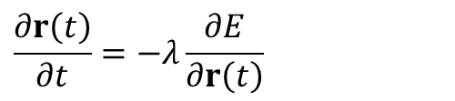

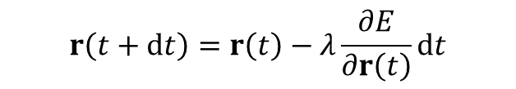
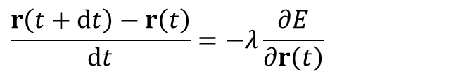
Gradient descent
Numerical methods
III
$$\frac{∂r\left(t\right)}{∂t}=−λ\frac{∂E}{∂r\left(t\right)}$$
$$\frac{r\left(t+dt\right)−r\left(t\right)}{dt}=−λ\frac{∂E}{∂r\left(t\right)}$$
$$r\left(t+dt\right)=r\left(t\right)−λ\frac{∂E}{∂r\left(t\right)}dt$$
The algorithm:
$$r_{n+1}=r_{n}−λ{∇E}_{n}dt$$
Cauchy, A. (1847). Méthode générale pour la résolution des systemes
d’équations simultanées. Comp. Rend. Sci. Paris, 25(1847), 536-538.‏
Where $r=(x,y)$ is a single aperture position.
Notes:
So how we did it numerically?
The most natural choice was gradient descent
Because the equation of motion itself acts just like the gradient descent algoritm
This is how it works:
So the X in the gradient descent equation resembles the movement of each aperture moving in the direction which minimizes the total energy of the system, which is the direction of the gradient of the energy
Or minus the gradient to be more exact
This method is very quick when following the minimizing path, But the main problem with gradient descent is that not always we are on the right path to minimum, especially when a lot of variables are involved
And more often than not we will get a local minimum instead of a global minimum, and when the system is very complex we wont even know that our minimum is not a global one
And this is why more methods were examined

Slide 28



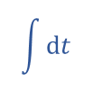
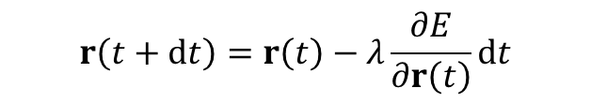
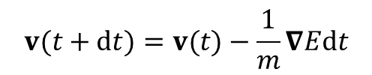
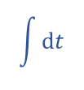

Momentum gradient descent
Numerical methods
IIIIII
$$\frac{∂r\left(t\right)}{∂t}=−λ\frac{∂E}{∂r\left(t\right)}$$
Changing the energy changes the velocity
$$r\left(t+dt\right)=r\left(t\right)−λ\frac{∂E}{∂r\left(t\right)}dt$$
Changing the energy changes the velocity rate
$$a=−\frac{1}{m}∇E$$
$$\int{dt}$$
$$v(t+dt)=v(t)−\frac{1}{m}∇Edt$$
$$\int{dt}$$
$$r\left(t+dt\right)=r\left(t\right)+v(t+dt)dt$$
The algorithm:
$$v_{n+1}=βv_{n}+(1−β) {∇E}_{n}$$
$$r_{n+1}=r_{n}−v_{n+1}dt$$
Polyak, B. T. (1964). Some methods of speeding up the convergence of iteration methods.
Ussr computational mathematics and mathematical physics, 4(5), 1-17.‏
Notes:
The first natural improvement for gradient descent is momentum gradient descent
In regular gradient descent – the velocity is proportional to the gradient of the energy, or in other words – to the force
But in proper physical system, the force is proportional to the acceleration and not velocity
So instead of when changing the energy – it would lead to a straight forward change in the movement of the apertures
Now a change in the energy will lead to a change in the rate of the apertures movement
Which means the movement itself will be more affected by the previous changes they experienced instead of the immediate change
That way the algorithm is supposed to move more quickly to the minimum, and at higher chance that will be the global minimum
Because that way we will pass by the shallow local minima with a non zero velocity, on the way to a deeper minimum, and on flat surfaces we will move quicker because we have momentum from a higher energy initial state

Slide 29



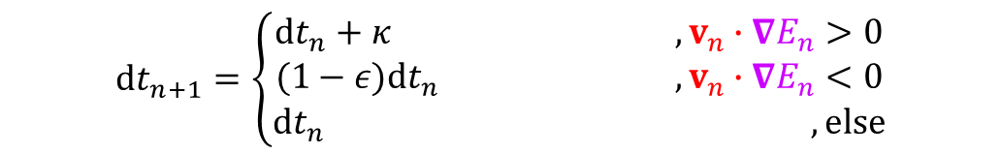



Delta-bar-delta
Numerical methods
IIIIII
The same main algorithm of momentum gradient descent:
$$v_{n+1}=βv_{n}+(1−β) {∇E}_{n}$$
$$r_{n+1}=r_{n}−v_{n+1}dt$$
$$v$$
But now step size updates every move:
$$∇E$$
$${dt}_{n+1}=\left\{\begin{aligned}{dt}_{n}+κ , v_{n}∙{∇E}_{n}>0 \\ (1−ε){dt}_{n} ,v_{n}∙{∇E}_{n}<0 \\ {dt}_{n} ,else\end{aligned}\right.$$
$$v$$
$$∇E$$
Jacobs, R. A. (1988). Increased rates of convergence through learning rate adaptation. Neural networks, 1(4), 295-307.
Notes:
even momentum gradient descent can be quicker and more optimpized – by adapting the step size dt depending on the surrounding
And we can do that by a method like delta bar delta, which is a name taken from computer science AI algorithm or something like that, because of how they name the parameters
The algorithm is taking the previous equations from momentum gradient descent
But now we have terms on dt size change
If the aperture propagates in the right direction – in the direction in which the energy is getting smaller – we want the step size to increase more and more to speed up the process in which we anyway move in the right direction, and that increase in the size of dt is going to be linear, that is a recursive form of writing linear equation
But if we passed the minimum and now we climb the hill of energy, now we are quickly going to shrink back the size of dt, in an exponential pace, again this is a way to write exponential decay in a recursive way,
This is an exponential decay in the size of dt so we can quickly stop our movement the moment we realized we are on the wrong direction
But not always dt will become zero when the movement stops, because dt and the velocity are two separate parameters, and the velocity of the aperture depends on what we previously discussed, and it has a momentum
And that momentum is the reason we will pass by the minimum in the first place, something that wouldn’t happen with regular gradient descent, but it’s a trade off for the quicker algorithm momentum gradient descent is
so now after we stoped the motion, our momentum is zero and the only thing that affects the movement is the gradient, so we have no other choice but to purely follow the gradient now, back to the minimum, with smaller dt which will help us get to the minimum in a more delicate slow pace
If the exponent parameter - which determines the pace the exponent will decay – is large enough, dt could reach zero before the velocity does and the aperture motion will stop
But it also means we will start the right direction later on with zero dt and that is wasteful, so this should be a delicate choice of parameters
Also kappa which is the slope of the linear growth of dt when its in the right direction, large kappa is quicker movement over time, which is nice when we are heading towards the minimum, but is also means we are going to pass by the minimum by a lot and we will have a large return path to go through, and this is also wasteful
So again, a judicious choice is needed here

Slide 30
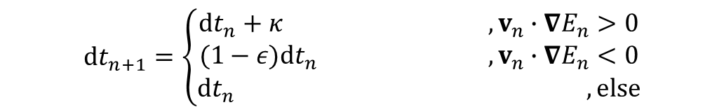
Delta-bar-delta
Numerical methods
IIIIII
The same main algorithm of momentum gradient descent:
$$v_{n+1}=βv_{n}+(1−β) {∇E}_{n}$$
$$r_{n+1}=r_{n}−v_{n+1}dt$$
But now step size updates every move:
$${dt}_{n+1}=\left\{\begin{aligned}{dt}_{n}+κ , v_{n}∙{∇E}_{n}>0 \\ (1−ε){dt}_{n} ,v_{n}∙{∇E}_{n}<0 \\ {dt}_{n} ,else\end{aligned}\right.$$
Jacobs, R. A. (1988). Increased rates of convergence through learning rate adaptation. Neural networks, 1(4), 295-307.
Notes:
So now the aperture moves quicker when getting closer to the minimum than in momentum gradient descent
And a little bit slower when moving away from the minimum
Which has its pros and cons as well, because that means we can get stuck easier on local minima than in momentum gradient descent, but that is the trade off for being sometimes way way quicker, especially in areas of shallow steepnesses

Slide 31










Simulated annealing
Numerical methods
III
The algorithm:
$$r_{n+1}=r_{n}+$$
random move
$$P(accept)=\left\{\begin{aligned}1 ,E_{n+1}< E_{n} \\ e^{−\frac{(E_{n+1}−E_{n})}{k_{B}T_{n}}} ,E_{n+1}> E_{n}\end{aligned}\right.$$
A selected cooling function
Example:
$$T_{n+1}=AT_{n} ,A<1$$
$$0$$
$$e^{−\frac{∆E}{k_{B}T}}$$
$$<$$
$$<$$
$$1$$
$$k_{B}T≪∆E$$
$$k_{B}T≫∆E$$
Kirkpatrick, S. et al (1983) Optimization by simulated annealing. Science 220(4598): 671–680.doi:10.1126/science.220.4598.671.
Notes:
The next algorithm that was studied is called simulated annealing
The basics of this algorithm is that the moving along space is actually random,
And the thing that determines what move is chosen is by the following probability:
So if the random move that was made, caused the energy to be smaller, the move is accepted
And if the move caused the energy to go up, the move will be accepted by the Boltzman probability function
That means, if a move caused the energy to go up by a lot, compared to the previous step energy, the system has to have a very high temperature in order to accept that move.
If the temperature is low, the grater the move, the less probable it to be accepted
The temperature is also a function which changes with the progression of the steps
We can put any function for the temperature, as long it makes sense
We want the temperature to eventually go down over time. The rate of the cooling will come from the function
A simple example is an exponential cooling. We already saw that this is a recursive way to write exponents
That means at first the temperature will be very high and will accept a lot of moves, maybe even all of them if its high enough, and will go down to zero at the end of the run
That way at first we can get a lot of crazy configurations and over time as the system cools down, it will accept less and less moves that makes its energy higher, and mostly will move towards its minimum.
That idea here is that all these random moves that enlarge the system energy that get accepted from time to time, will help it to get out of a local minimum and get towards the global minimum, or at least a lower local minimum
Another thing that can be determined here is the random move probability distribution
What we ended up doing is making the moves go by the exponential distribution, which means there is more probability to get smaller step sizes than larger, but once in a while a large move will arrive, and maybe even accepted

Slide 32














Simulated annealing – modified Lam
Numerical methods
III
$$E_{n+1}< E_{n}$$
$$E_{n+1}> E_{n}$$
$e^{−\frac{∆E}{k_{B}T_{n}}}$> random
$e^{−\frac{∆E}{k_{B}T_{n}}}$< random
Lam rate
acceptance rate
accepting
declining
acceptance rate increases
acceptance rate decreases
steps
acceptance rate < Lam rate
$$e^{−\frac{∆E}{k_{B}T}}$$
Lam rate
$T$ increases
$$0$$
$$<$$
$$<$$
$$1$$
Lam rate
acceptance rate > Lam rate
$T$ decreases
$$k_{B}T≪∆E$$
$$k_{B}T≫∆E$$
Swartz, W.P. (1993) Automatic Layout of Analog and Digital Mixed Macro/Standard Cell Integrated Circuits. Ph.D. thesis, Yale University.
Notes:
The problem with simulated annealing as is, is that its not robust for every situation in the system all the time
For instance, if the system reaches a very deep local minima, which isn’t the desired one,
In order for the system to get out of the deep well, the delta in energy between the current state and the next step – has to be at least in the order of magnitude of the current temperature, if not smaller than the temperature
But maybe the temperature we initially put wasn’t prepared for that situation, because for any other energy wells it works great,
And we cant know every height of every well in the energy space, there are too many parameters for that
So what this algorithm does is instead of initiating the temperature and give it a function to follow,
We will initiate the rate of acceptance of states, and the temperature will increase or decrease to make that rate happen
If the rate of acceptance is high, the temperature will decrease to make the probability lower and thus accept less, and vice versa
The acceptance rate we aspire to get is Lam rate, and was found to be working welld , and the algorithm is always working to make the acceptance rate as close as possible to the Lam rate
The Lam rate is high at first and exponentially decaying to a fixed value which is 0.44, which again found to be a good number for this algorithm, and by the end of the run the rate drops exponentially to zero and that’s when the system is getting its last organizing to the final configuration
What we did to make it more efficient is when the system enters to the last step is giving it the minimal energy configuration to run with it until the end

Slide 33








3-6 apertures
Results
IIIII
3
4
5
6
Achieved by simulated annealing algorithm (modified Lam), parameters: $c=2, g=1, 2≤γ≤16$
Notes:
Here are some results for different number of apertures
On the top part these are the configurations of the apertures, each dot is a point like dot, not resembling the actual size of the aperture to see it more clearly
The bottom part shows the MTF calculating the actual size of the aperture
As you can see the algorithm gives a very smooth and not redundant solutions for the MTF

Slide 34








7-10 apertures
Results
IIIII
7
8
9
10
Achieved by simulated annealing algorithm (modified Lam), parameters: $c=2, g=1, 2≤γ≤16$
Notes:
At larger aperture numbers we can see its less trivial to get a connected shape, and there are going to be also holes inside
But there are trade offs to everything
And compared to golay it gives more compact MTFs
And compared to mugnier its not a single form but it also doesn’t give redundancy

Slide 35
















Parameter dependance
Results
IIIII
When changing the ratio $c/g$
Distance between points in MTF changes on minimal state
$$E=\iint{\left(c{\left|∇ρ\left(u,v\right)\right|}^{2}+\frac{1}{2}g{\left|ρ\left(u,v\right)\right|}^{2}\right)\text{d}u\text{d}v}$$
$$c/g=100$$
$$c/g=10$$
$$c/g=2$$
$c/g=1/2$
$c/g=1/4$
$c/g=1/16$
$c/g=1/30$
$c/g=1/100$
Notes:
When changing the ratio $c/g$
The distance between the points in MTF changes on minimal state
The overall numbers aren’t important because the energy is up to a constant, but the ratio between them is important
When the ratio is larger – the MTF will be more compact and smoother
When the ratio is smaller – the MTF points will be more spread out and the height will be less smooth
The ability to change the parameters is important and enable the user the flexibility for stretching out the cut-off frequency to the max without getting holes and lose middle frequencies because of that
On the other hand for a user wanting the MTF to be as smooth as possible – that is also an option

Slide 36





Parameter dependance
Results
IIIII
When raising the power $γ$
Minimal states avoid redundancy
$$E=\iint{\left(c{\left|∇ρ\left(u,v\right)\right|}^{2}+\frac{1}{2}g{\left|ρ\left(u,v\right)\right|}^{γ}\right)\text{d}u\text{d}v}$$
The power $γ$ raises the energetic cost for MTF values above 1.
When $γ=2$ at higher aperture numbers:
7
8
9
10
7
8
Achieved by simulated annealing algorithm (modified Lam), parameters: $c=2, g=1, γ=2$
Notes:
When changing the power gamma of the non linear term in the energy
We get a way to “punish” the configuration to be non redundant if the power 2 isn’t enough aat a certain number of apertures
The energetic cost of a MTF value to be more than 1 (or in other words redundant by our scaling) is increasingly high the higher gamma is
These are all results of a higher number of apertures in which gamma=2 isn’t enough anymore, and these are all result of plugging gamma=2
We can see that when gamma is low and we get redundancy – the results are still overall very smooth except for few dots that are redundant, and even then, with the right gamma we can get results with redundancy that isn’t full (with the value 2), but lower than that, which means that with high resolution detection one can still tell apart the redundant dots in the MTF
which is better than full redundancy as in Mugnier approach, even when redundancy is happening in our results
The higher the number of the apertures- the higher gamma should be in order to disable redundant options
Another thing worth mentioning is that when there is a redundancy in the MTF – the overall shape is less likely to have fringes and holes, because it opens up more configuration possibilities, while organizing with no redundancy makes heavy constrains on the possible places the apertures could be what makes them go further and create holes and non compact dots around the MTF main area

Slide 37

Potential
Results
IIIII
We used a round potential well to confine the MTF in radius, in order to:
Eliminate unnecessary far random walks of apertures.
Make the run more efficient.
Improve mid-frequency coverage.
Control the cut-off frequency by demand.
Control the overall shape of the MTF if wanted.
$$E=\iint{\left(c{\left|∇ρ\left(u,v\right)\right|}^{2}+\frac{1}{2}V\left(u,v\right)ρ\left(u,v\right)+\frac{1}{2}g{\left|ρ\left(u,v\right)\right|}^{γ}\right)\text{d}u\text{d}v}$$
20 apertures forming MTF in a round potential well
Achieved by simulated annealing algorithm (modified Lam), parameters: $c=1, g=100, γ=2$
Notes:
we confined the MTF inside a desirable potential well
It can help with eliminate the random walk the apertures are doing when simulated annealing draw random moves that are unnecessarily far
These moves are anyway not wanted because they make the MTF patchy and spread out too much
So when we do that potential it is placed already when we draw random moves, so before we run these new steps and waste running time, we first make sure the new random step is inside that potential well (that means it’s a sharp infinite potential)
And that makes the run be way more efficient
And also by that we can actively control the MTF and the apertures shape in both spaces
That means that if we want a certain shape or size of the apertures space or MTF to be we can control that
And combined with the control of how much spread out the MTF can be by c and g we can fill any space of MTF radius we want by MTF points
Here an example for 20 apertures inside a sharp potential with a radius in the size of 23*R where R is the apertures radius

Slide 38
Summary
Introduction
Telescope arrays are the future of space imaging, but are hard to develop.
The project focus: arranging sub-apertures as an optical imaging system.
The goal: getting a compact & smooth modulation transfer function (MTF).
We used an analogy: sub-apertures act like particles governed by nonlinear forces.
By finding the lowest-energy state, we get an optimal optical arrangement.
Notes:
Telescope arrays are becoming the future for space imaging, but are hard to develop. When they are designed properly, they can lead to significant discoveries
The project focuses on arranging sub-apertures in a sparse segmented optical imaging system.
Which is a system that has multiple apertures combined together to create a single image
The goal is to get a compact and smooth modulation transfer function (MTF).
And I will get to why later on in the talk
We used a model where the sub-apertures act like particles that are governed by nonlinear forces in the schrodinger equation
And by finding the lowest-energy state, we get an optimal optical arrangement – for any size or shape of aperture

Slide 39
Conclusions
Designing sparse segmented telescopes is challenging due to endless combinations and trade-offs between frequency coverage, redundancy, and compactness.
Analogies to physical systems are a helpful tool.
Simulated annealing is a robust algorithm for large parametric spaces.
There are sufficient solutions for compact non-redundant MTF configurations, with some trade-offs as aperture number increases.
This algorithm is applicable to any shape and size of apertures for various design requirements.
Notes:
Designing sparse segmented telescopes is challenging due to endless combinations and trade-offs between coverage, redundancy, and compactness.
Analogies to physical systems are a helpful tool.
Simulated annealing is a robust algorithm for large parametric spaces.
There are sufficient solutions for compact non-redundant MTF configurations, with some trade-offs as aperture number increases.
This algorithm is applicable to any shape and size of apertures for various design requirements.

Slide 40
The end
Thank you for listening ☺
Notes:
Thank you for listening ☺

